Slide 1
Why Continous Delivery (CI / CD)
Continous Integration & Continous Deployment

Slide 2
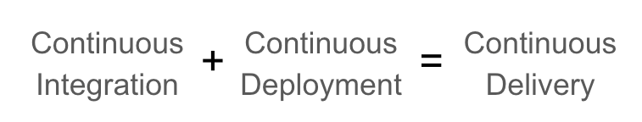
What is Continous Delivery
An engineering practice in which teams produce and release value in short cycles.
Continous Integration
The practice of merging all developers' working copies to a shared mainline several times a day.
Continous Deployment
A software engineering approach in which the value is delivered frequently through automated deployments.

Slide 3
What is CI / CD ?
CI/CD is a set of development practices aimed at automating the building, testing, and deployment of applications.
Before we implement CI/CD almost everything requires human intervention. Can you imagine a world without human error?
... Neither can I, but with CI/CD, we can reduce it!

Slide 4
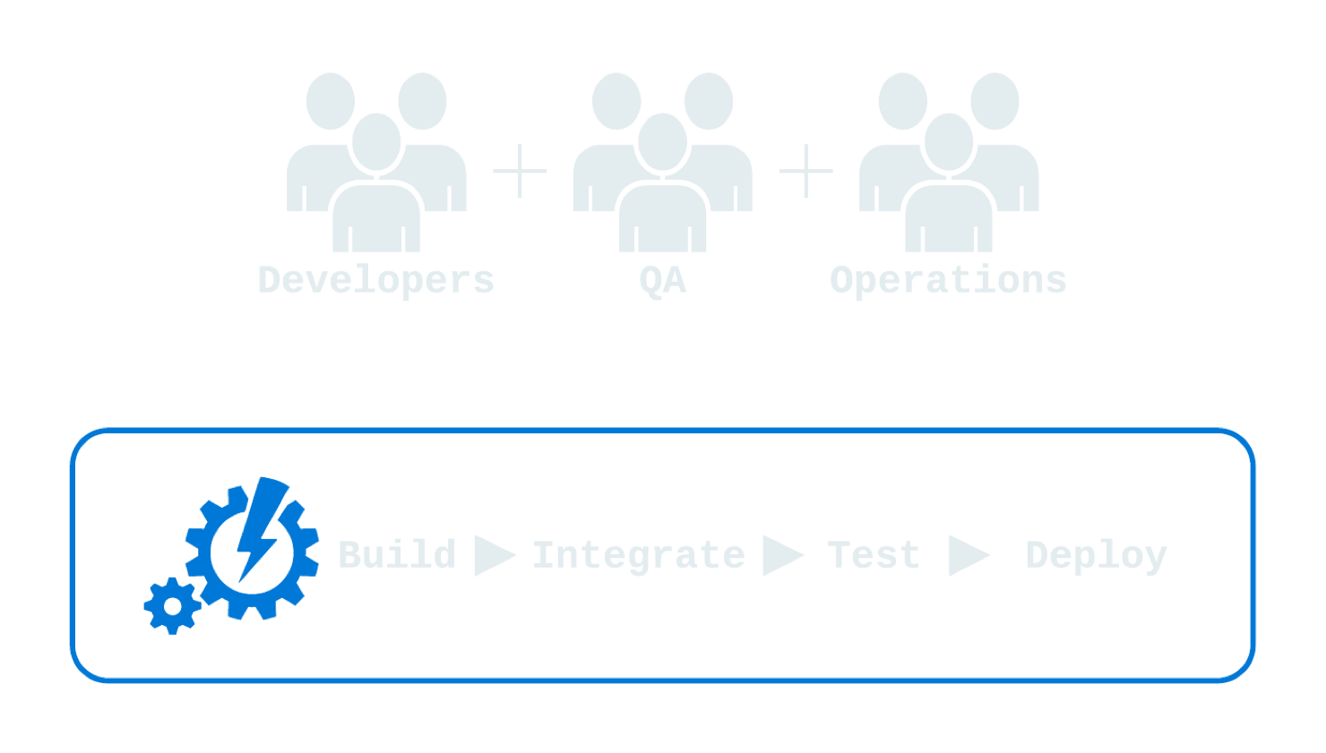


CI / CD benefits
Fast time-to-market (TTM)
Few production failures
Immediate recovery from failures

Slide 5
Why build automation
Fast – automation handles tasks that would need others to do it manually
Consistent – the build happens the same way everytime which removes problems
Repeatable – The build can be done multiplie times with the same results, new source code versions can transform into deployable code
Protable – the build can be done the same way on any machine
Reliable – there will be fewer problems caused by bad builds

Slide 6
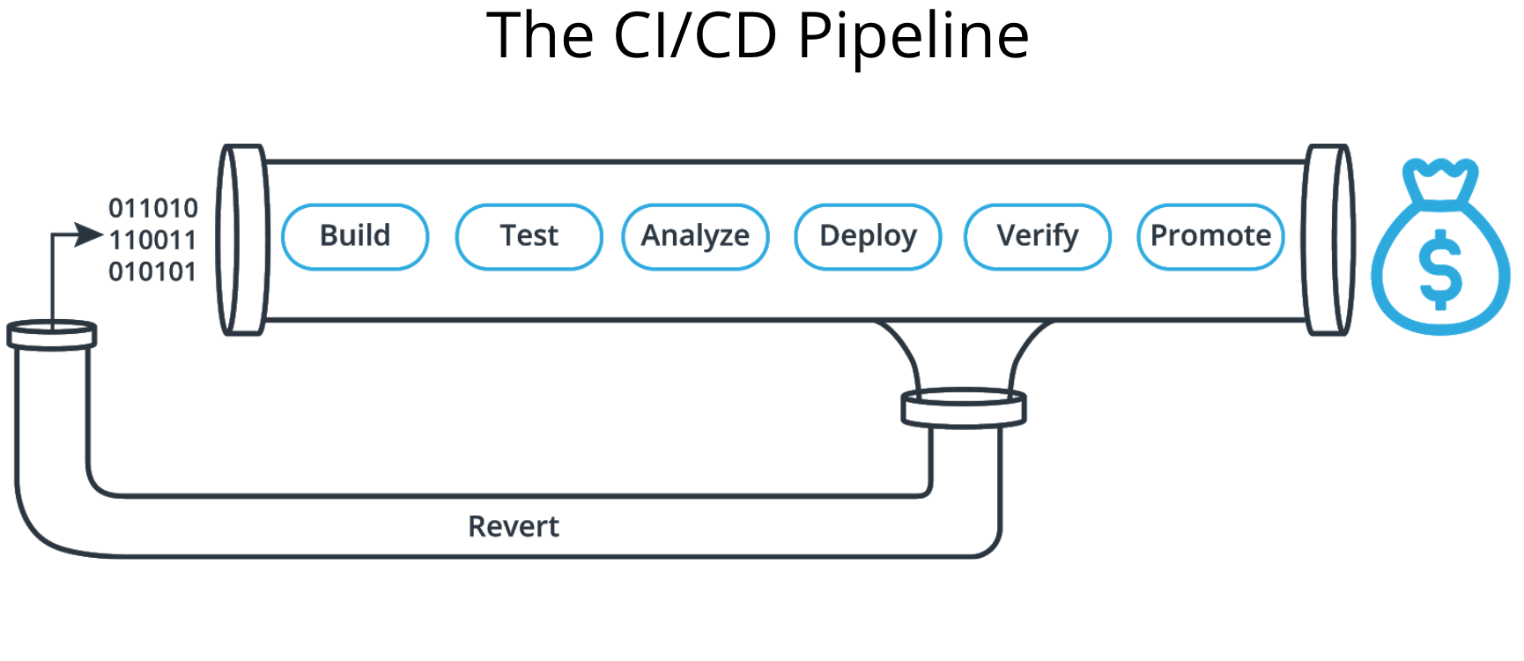
CI/CD for business
There is a needed question Is the company can handle non-required resources and thinking about provisioning new resources at the same time ? Is this a way to reduce cost of these conflicts happening at the ground level. Automate company's infrastructure is one if the approaches we can follow to reduce the cost of the unused resources and start utilizing them as per the load or the need.

Slide 7
CI/CD for business – Cont.
We always looking forward a kind of fast and reliable delivery of our product so we can do increase our revenue and produce the new features in a less time to market . This requires deploy to production without manual checks .

